Slide 1
MULTISCALE MODELLING OF COMPLEX BIOLOGICAL SYSTEMS
ZACKARY FALLS
RAM SAMUDRALA
DIVISION OF BIOINFORMATICS
DEPARTMENT OF BIOMEDICAL INFORMATICS
UNIVERSITY AT BUFFALO
http://compbio.org
How do genomes interact with environment to specify phenotype?
How to use this information to improve health and quality of life?
Notes:
1

Slide 2
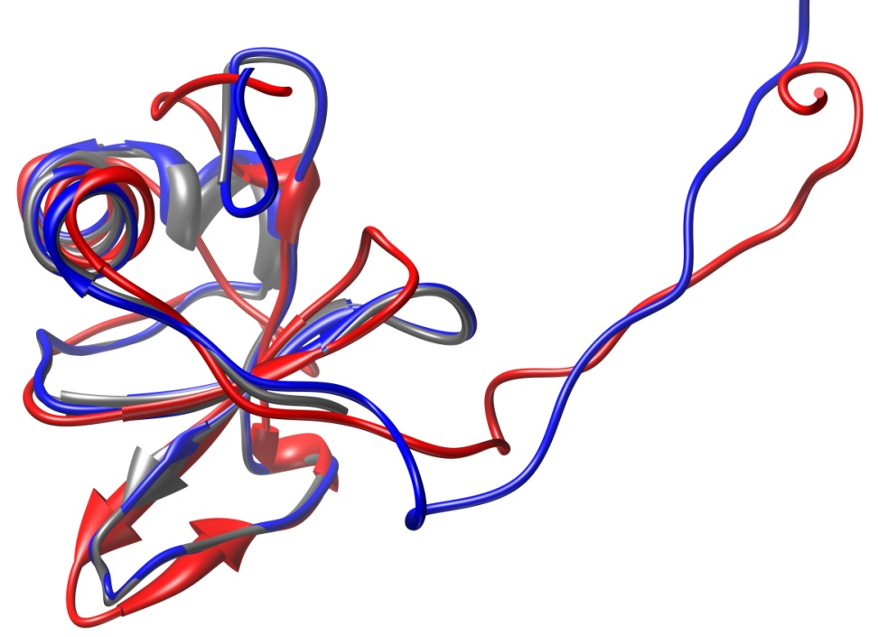
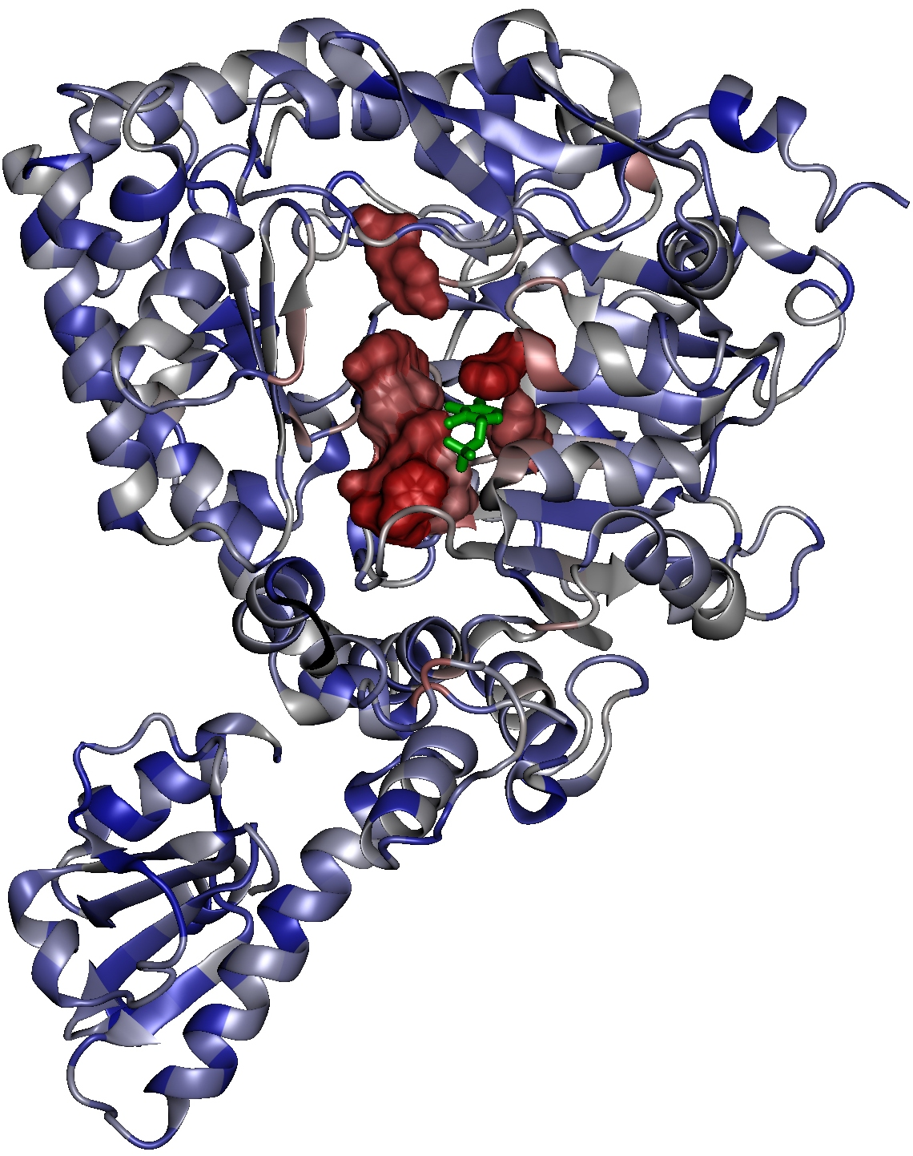
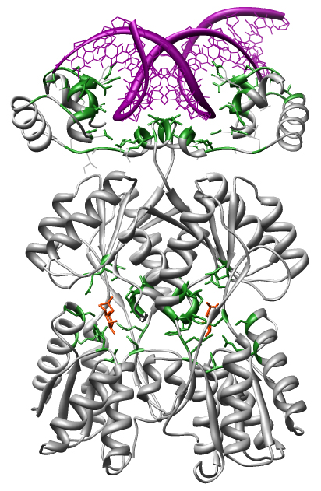
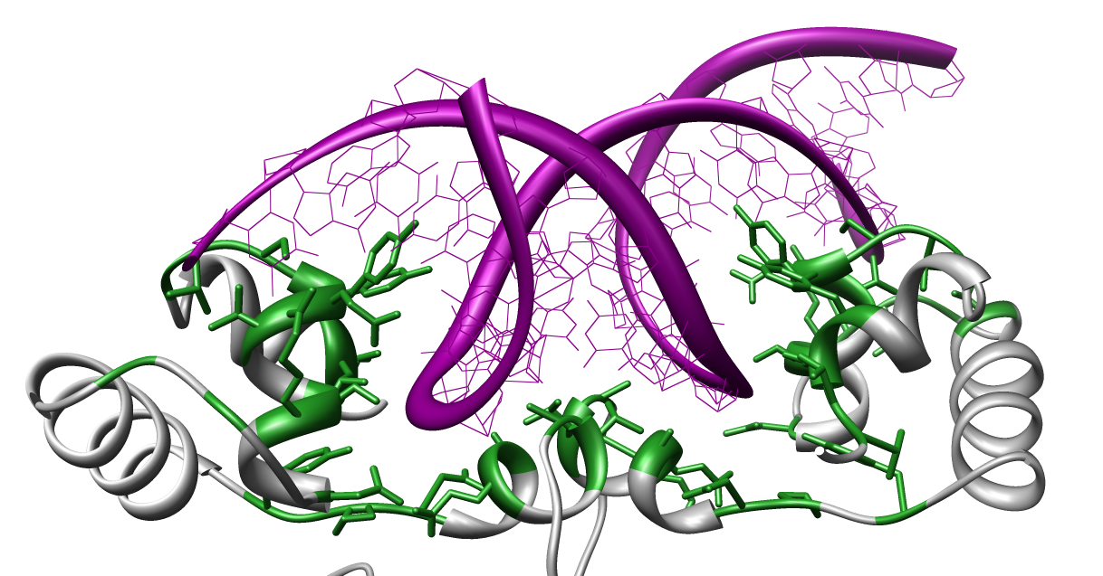
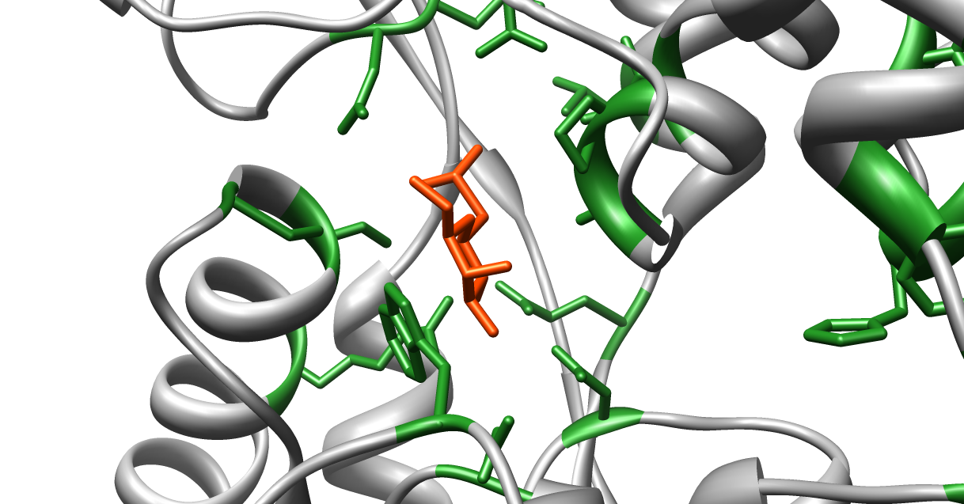
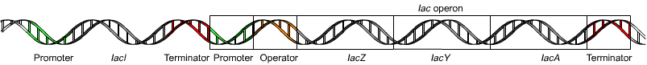
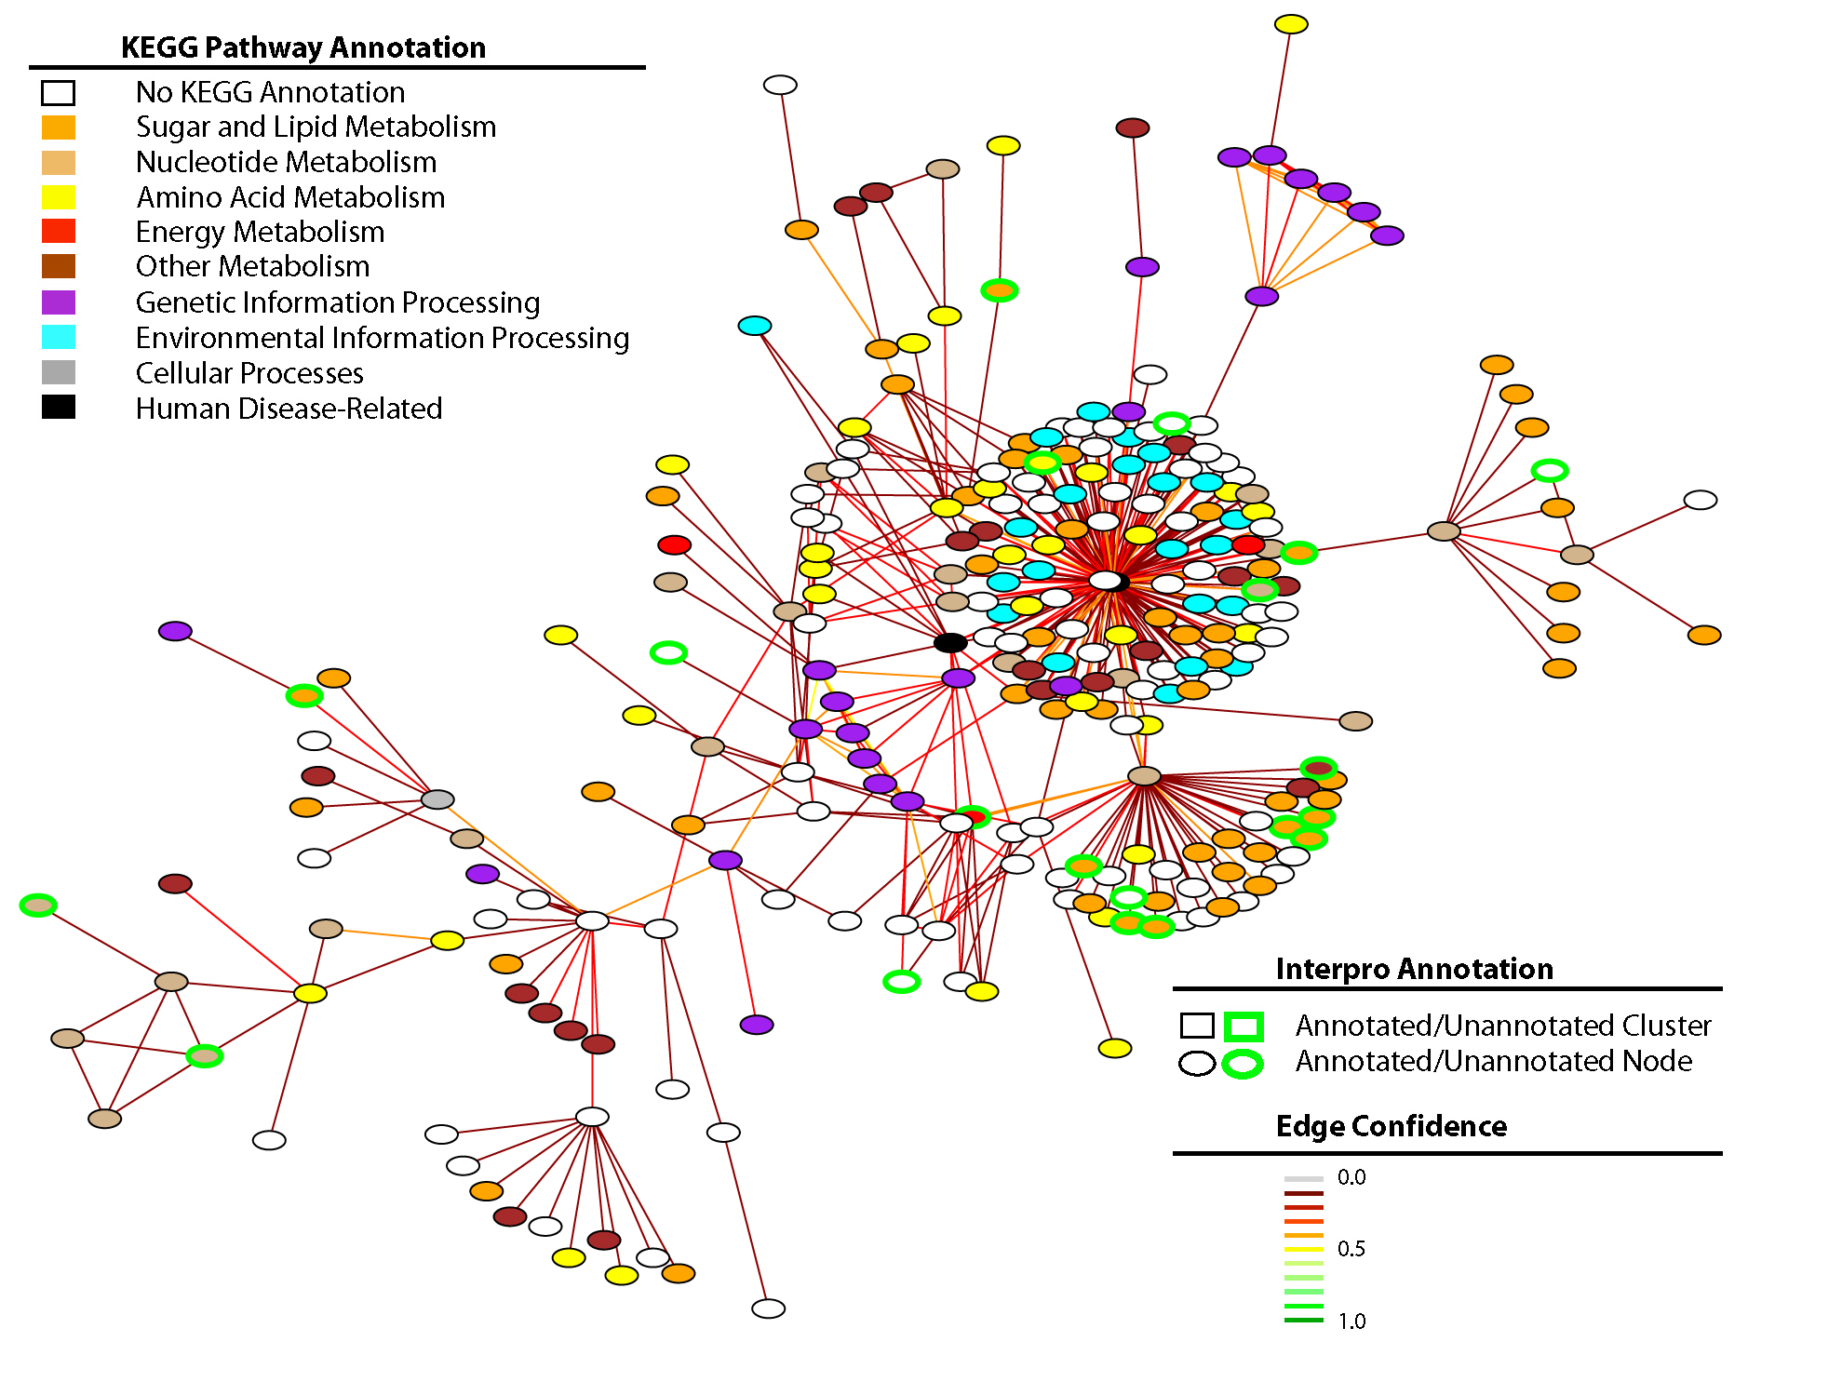
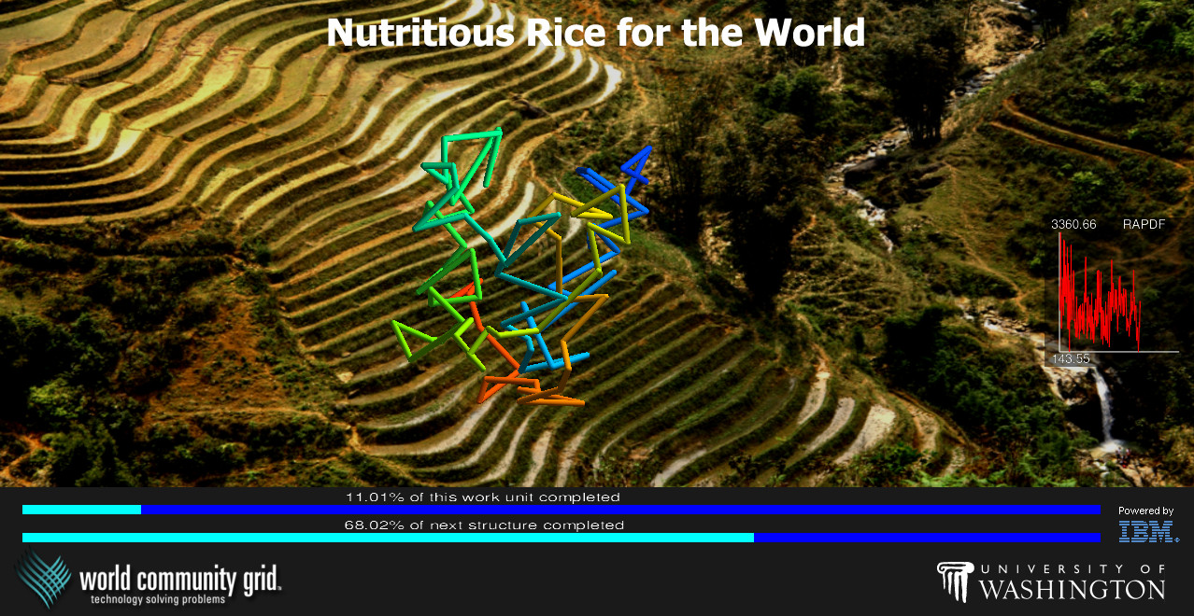
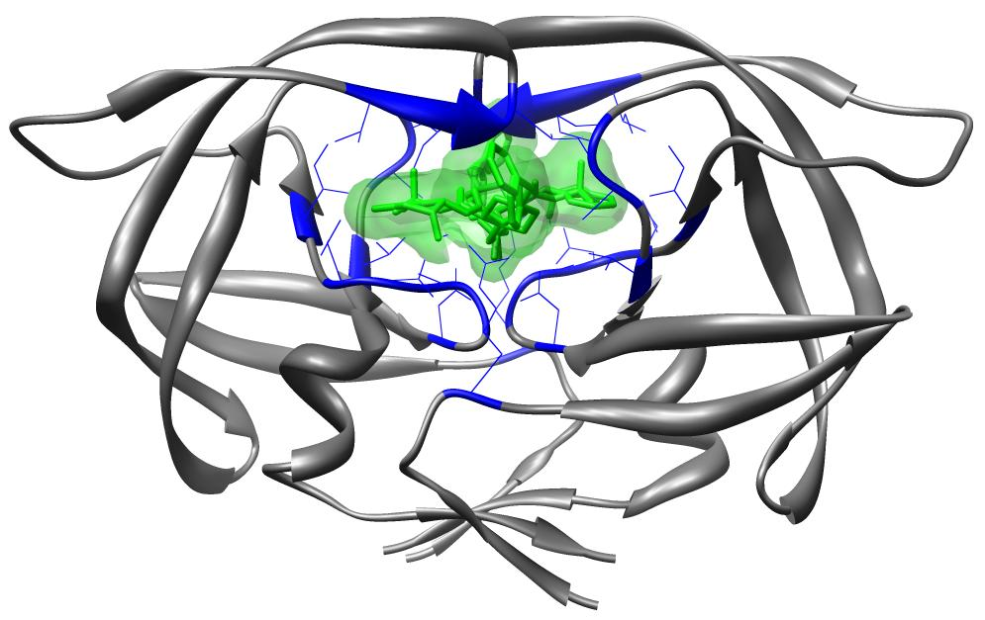
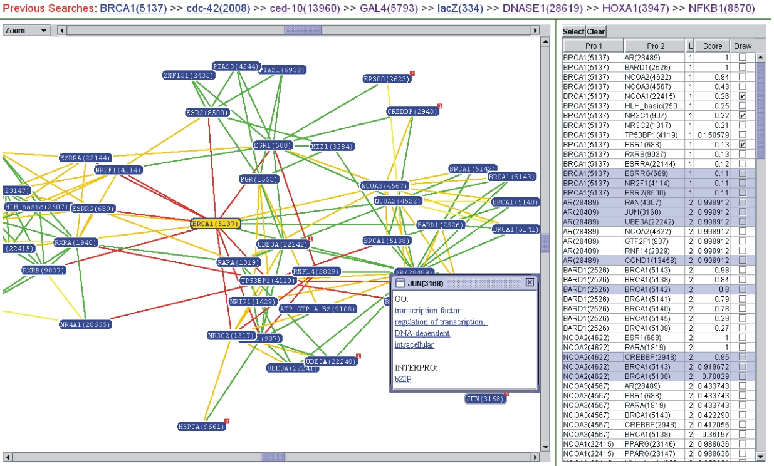
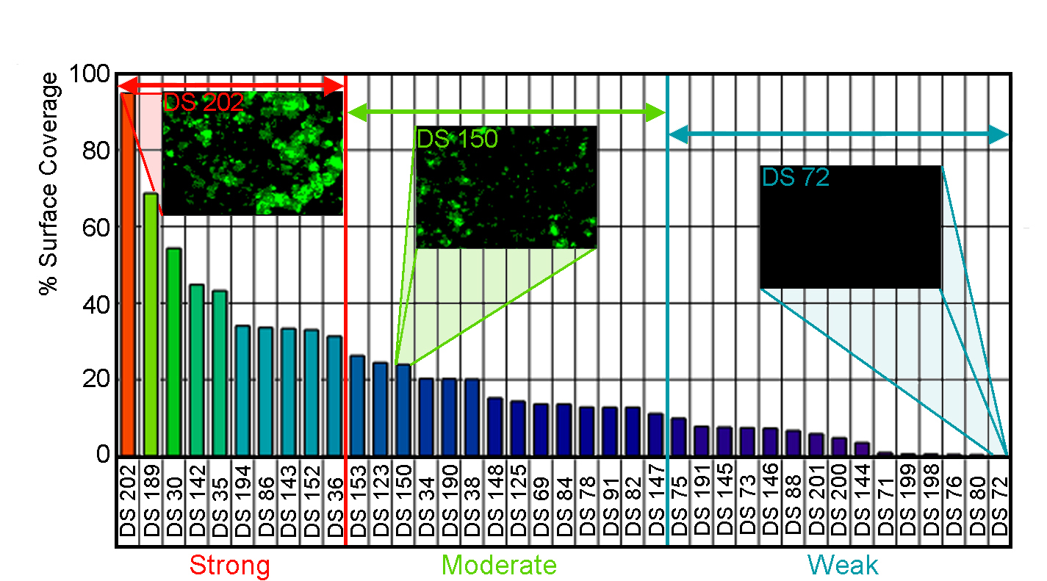
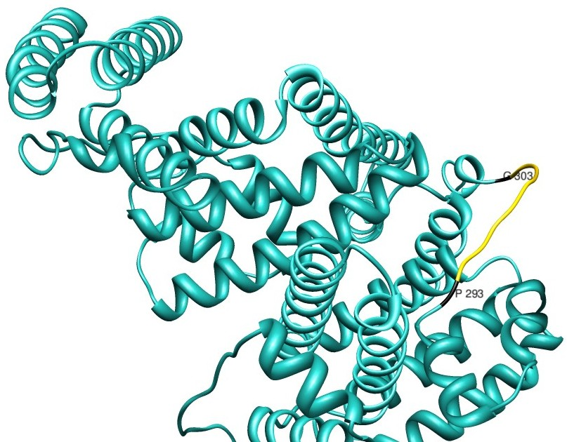
GENOME TO PROTEIN, PROTEOME, PHENOTYPE…
STRUCTURE
FUNCTION
INTERACTION
PROTEIN
DNA/RNA
COMPOUND
SYSTEMS
INFRASTRUCTURE
APPLICATIONS
RICE
THERAPEUTICS
NANOTECHNOLOGY
DESIGN
EVOLUTION

Slide 3
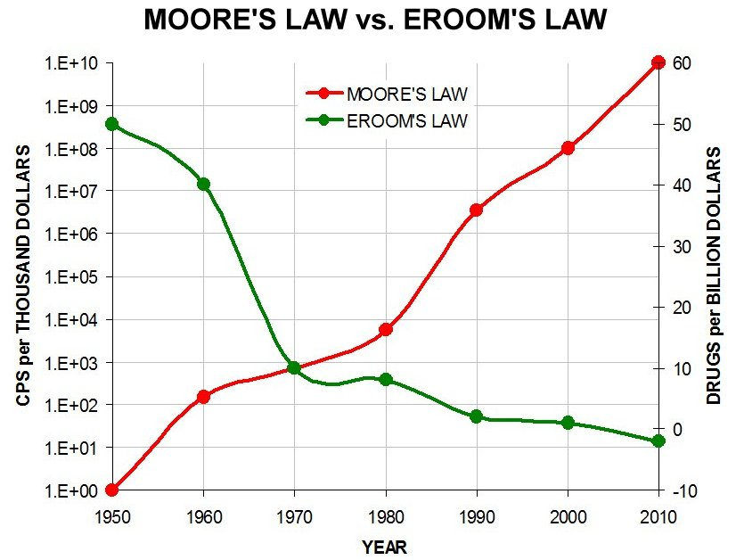
PROBLEM: NEW DRUG PIPELINE IS DRYING UP

Slide 4
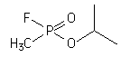
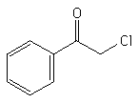
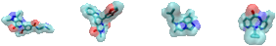
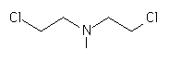


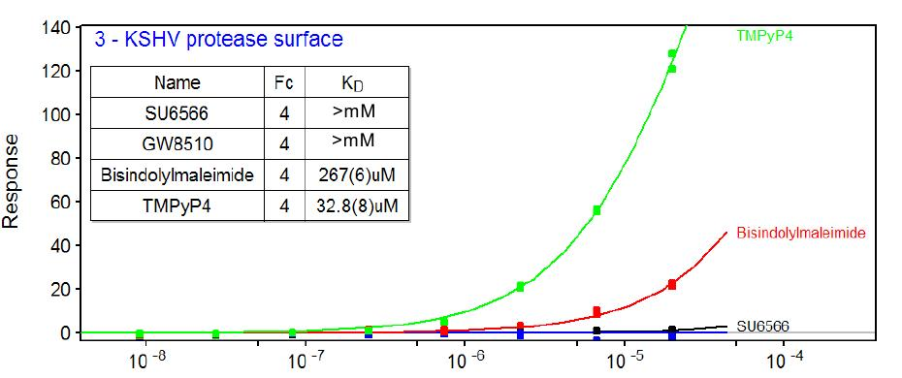
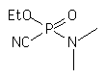
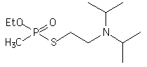
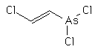

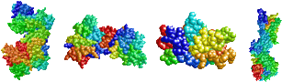
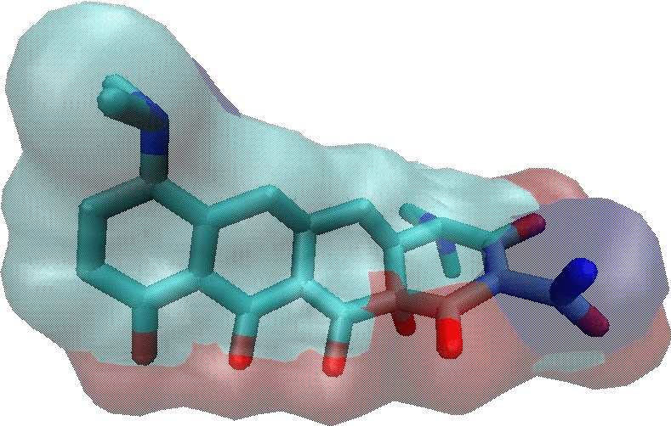
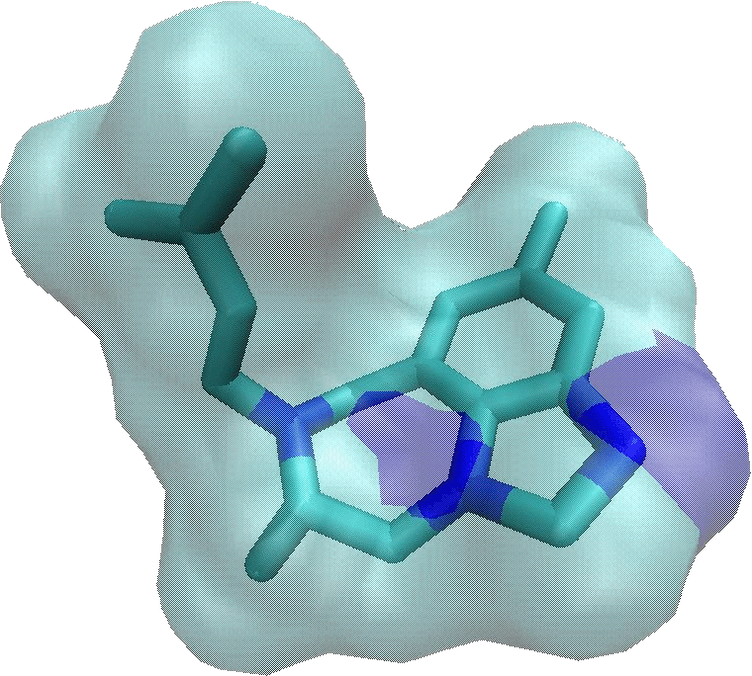
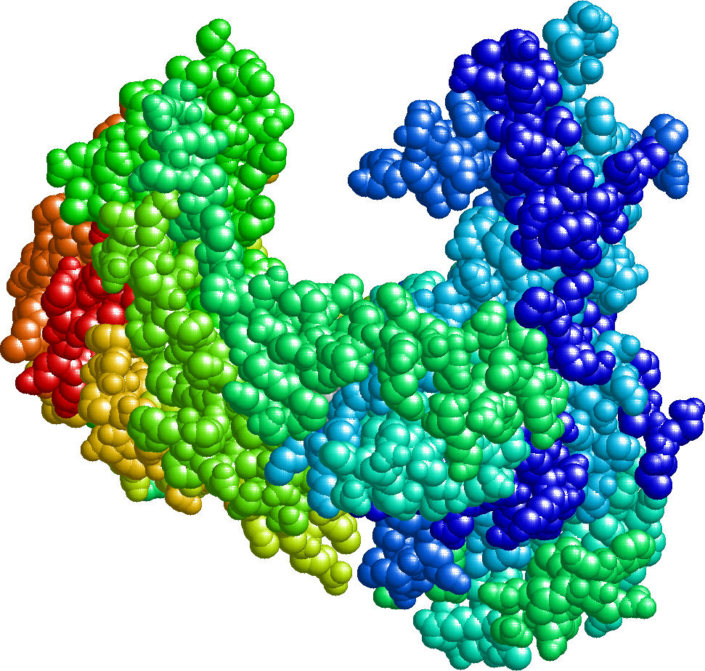

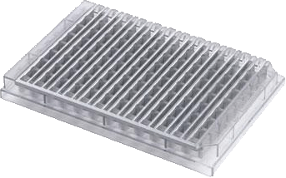
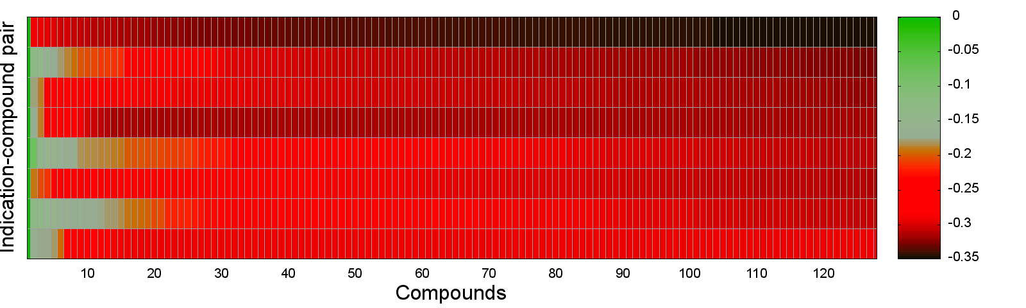


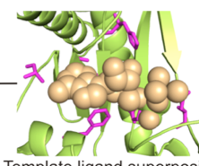
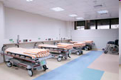
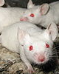
SOLUTION: SHOTGUN DRUG DISCOVERY – CANDO V1
ALL KNOWN DRUGS
(3733 FROM FDA, …)
HIERARCHICAL FRAGMENT
DOCKING WITH DYNAMICS
(1000,000,000+)
CANDO MATRIX
PRIORITISE HITS
DISSOCIATION CONSTANTS (KD)
(100s + collaborations)
+
ALL PROTEIN STRUCTURES
(48,278 SOLVED, MODELLED)
MACHINE
LEARNING
IN VITRO
STUDIES
COMPOUND-COMPOUND COMPARISON AND RANKING
THERAPEUTIC DISCOVERY
BIO/CHEM
INFORMATICS
PHARMACOLOGICAL
DATA INTEGRATION
INITIAL CLINICAL TRIALS
IN VIVO STUDIES

Slide 5
SOLUTION: SHOTGUN DRUG DISCOVERY – CANDO V2-3
Falls/Mangione/Overhoff/Hudson/Bruggemann/Mammen/Schuler/Moukheiber/Chopra

Slide 6
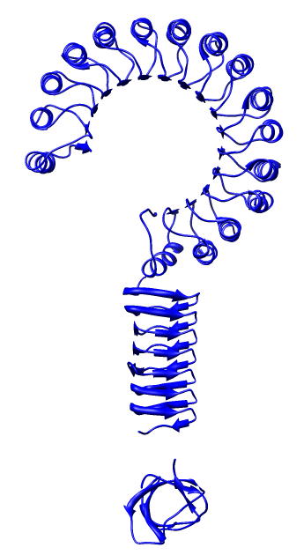
THE COMPREHENSIVE SOLUTION TO CHARACTERISE AND TREAT EVERY DISEASE
“It’s a small molecule world after all”
http://compbio.org
2bnh: alpha-beta horseshoe
1hv9: left-handed beta helix
1m30: SH3-like barrel

